Slide 1
STUDENT DEBTOR REFUND & CASHBOOK
PRESENTER: NICOLETTE FOURIE (NUST)
CHAIR: MELINDA DE WET (UJ)

Slide 2
OVERVIEW
BUSINESS PROCESS REFINED
03
PROBABLE SOLUTION
02
50
60
04
SET UPS ON ITS
40
70
30
80
20
90
10
100
0
110
01
05
PROBLEM IDENTIFIED
PROCESS FOR STUDENTS ON IENABLER
1

Slide 3
PROBLEM IDENTIFIED
Students still manually applied for refunds by tendering an application form.
01
02
Long queues.
03
Forms getting lost or misplaced and Audit queries

Slide 4
PROPOSED SOLUTION: A FULLY AUTOMATED PROCESS
RULES
TERMS & CONDITIONS
BANK AUTHORIZATION
RELEVANT APPROVALS

Slide 5
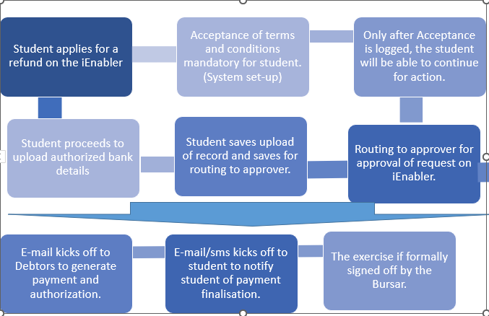
BUSINESS PROCESS REFINED

Slide 6
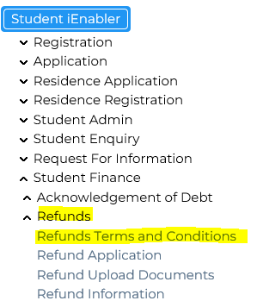
STUDENT VIEW: IENABLER REFUND APPLICATION

Slide 7
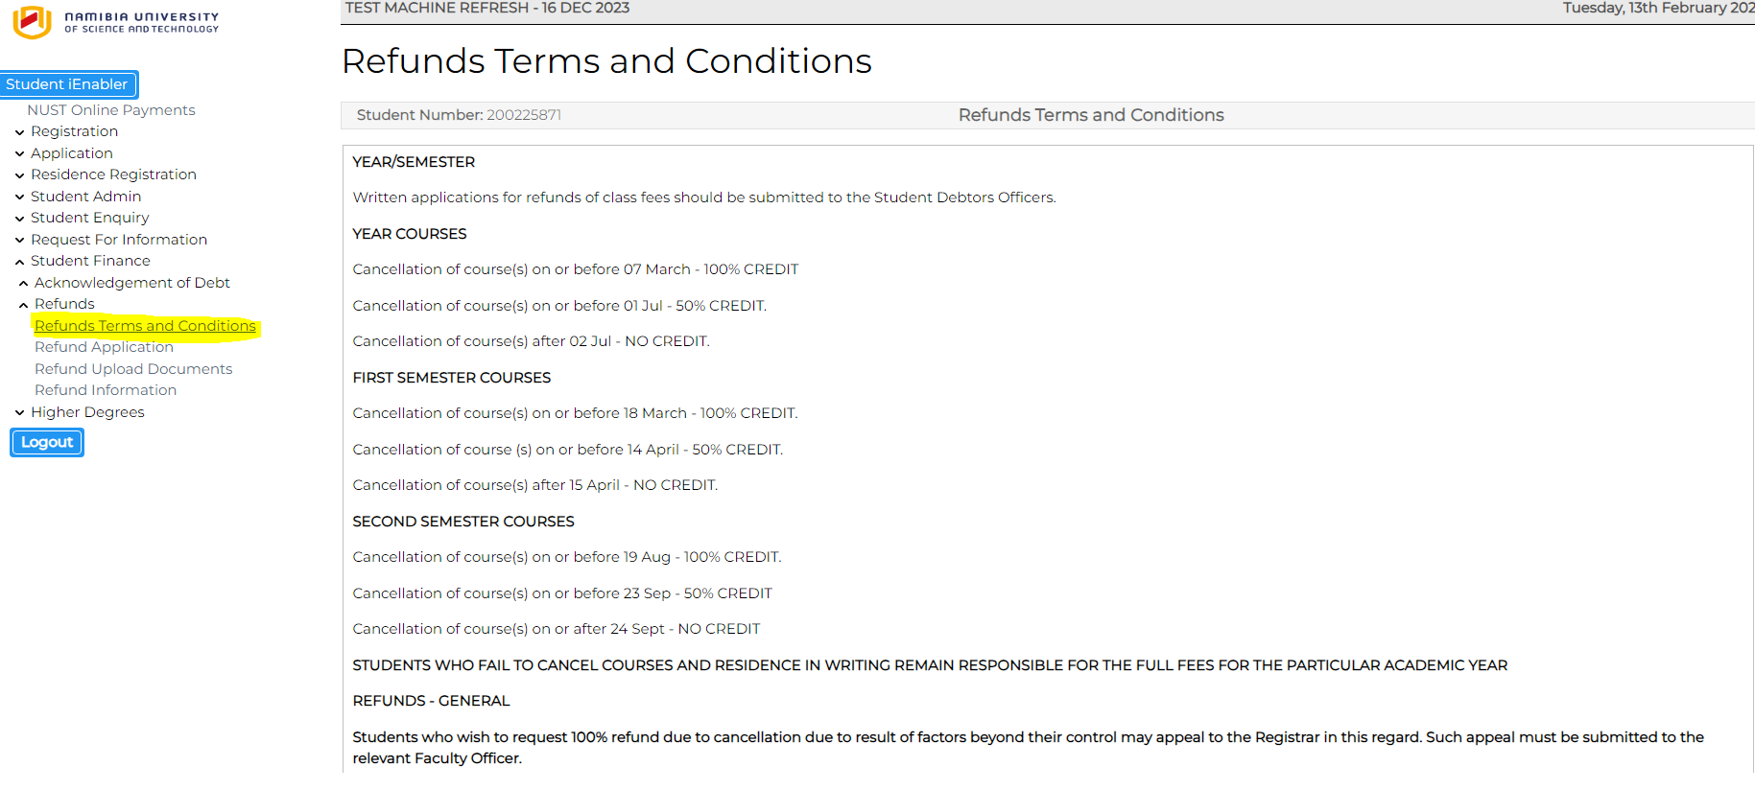
ACKNOWLEDGEMENT OF TERMS AND CONDITIONS AS SET UP:
MENU: SLLL-1: DOC CODE: RF

Slide 8
Once the terms and conditions are logged for acceptance, the student click on Refund Application: “Apply for Refund”:

Slide 9
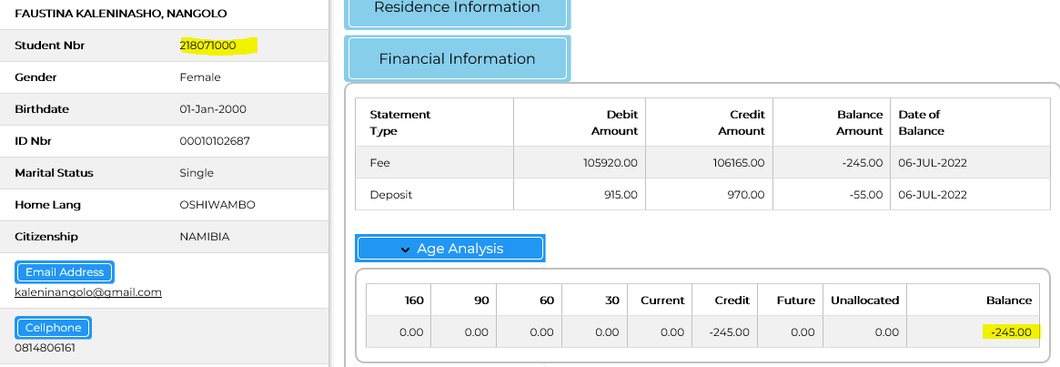
For a student to apply the statement should have a credit (Due to you) balance

Slide 10
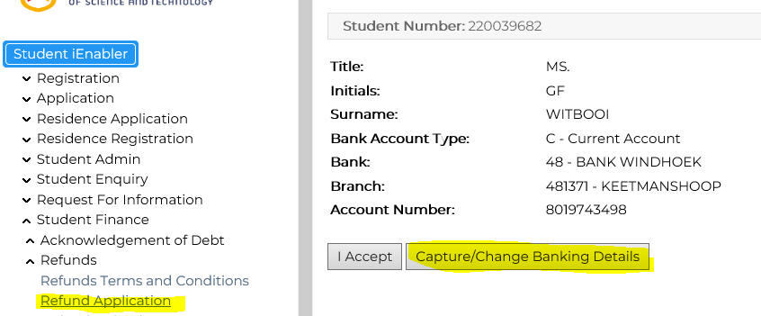
Bank details will appear. Click on “I agree” if you agree with the bank details. OR If no bank details appear, or bank details changed, the student will click on “Capture/Change banking details”

Slide 11
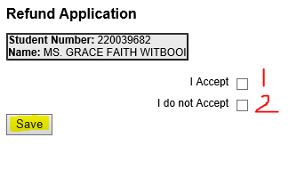
Once done capturing/changing banking details the student will either, “I accept” and if not, click on “I do not accept”
Student will then “Save” if agreed to proceed. and if you do not agree click on “I do not accept” and save if you agree to proceed:

Slide 12
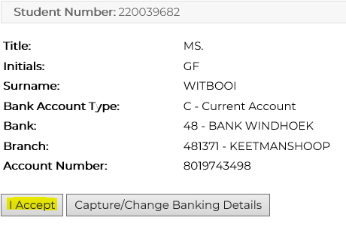
If bank details already exist for the student, and remains the same, the student may “Accept” and continue.

Slide 13
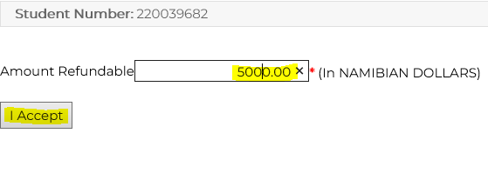
Upon saving the banking details, the student continues to enter the amount to be refunded (can be partially or the full amount): Partially refundable amount:

Slide 14
Step 7 (continue): Full refundable amount:

Slide 15
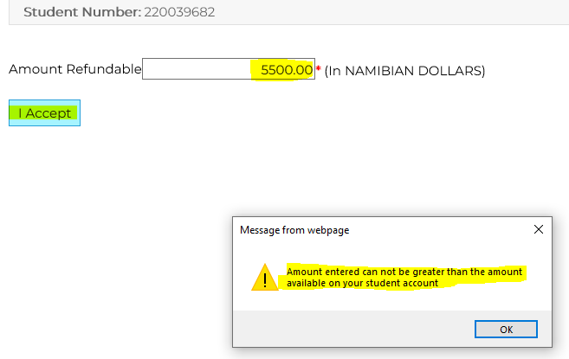
If the amount is exceeds the refund amount, an error message will pop-up and the student will not be allowed to proceed

Slide 16
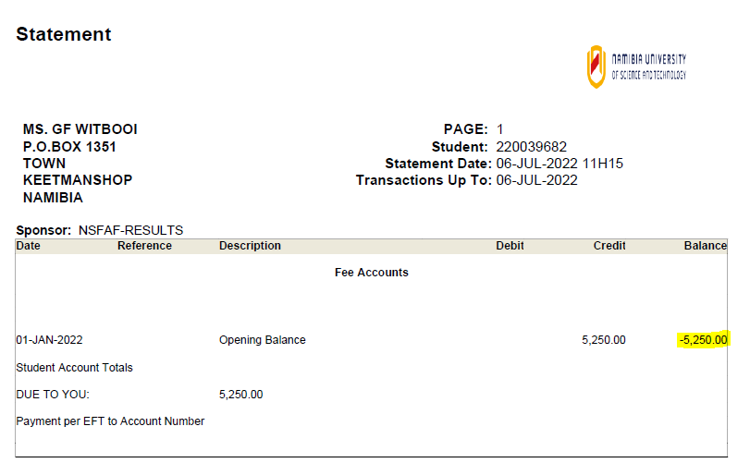
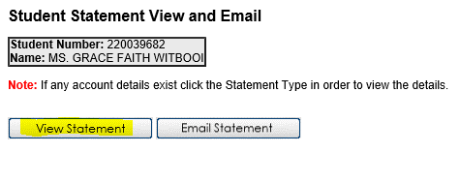
View the statement before the refund application:

Slide 17
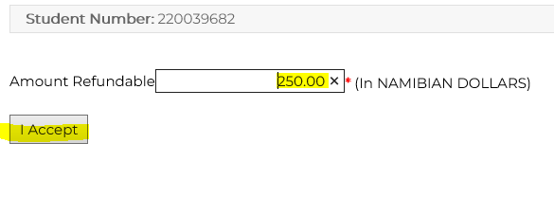
For purposes of this test case the partially amount to be refunded and was used to verify if the financial information to ensure that it was correctly updated: Start to process refund of N$ 250.00:

Slide 18
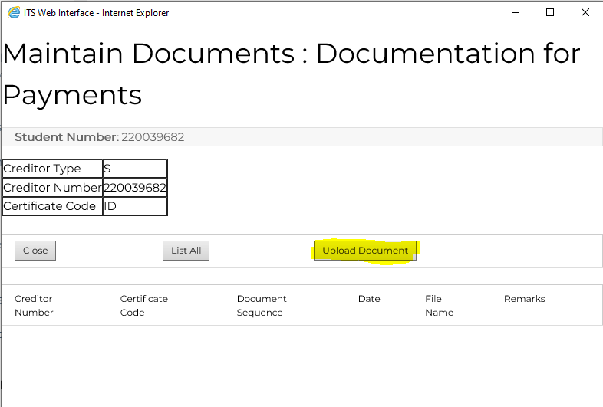
Once you click on “I accept”, it prompts the student to upload the authorized banking details form: Uploading of banking details to be mandatory for the refund

Slide 19
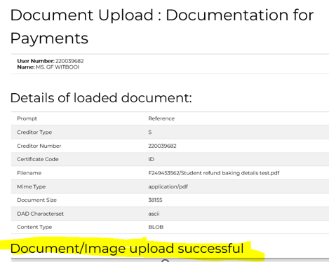
A message generates to state that the banking details form is successfully uploaded

Slide 20
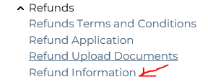
Once the banking details is successfully uploaded, the student may click on refund information to view the refund status.
Will read as “Payment request on Hold”:

Slide 21
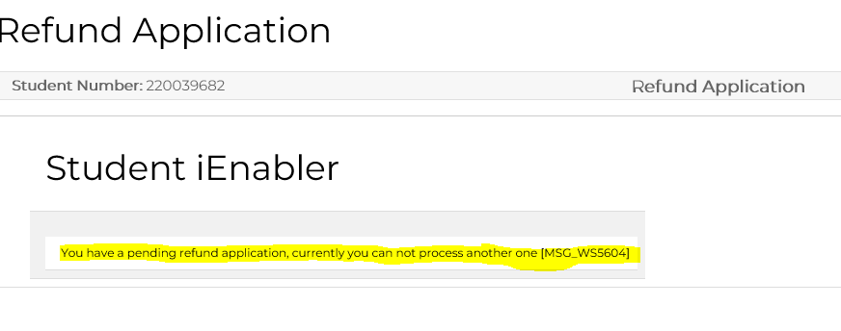
NOTE: Once applied for refund, a system validation will prohibit you from processing another. Displayed message below.
CONCLUDES THE PROCESS OF THE STUDENT REFUND APPLICATION ON I-ENABLER
STUDENT AND THE STUDENT DEBTORS OFFICE WILL BE NOTIFIED OF EACH PROCESS VIA EMAIL.

Slide 22
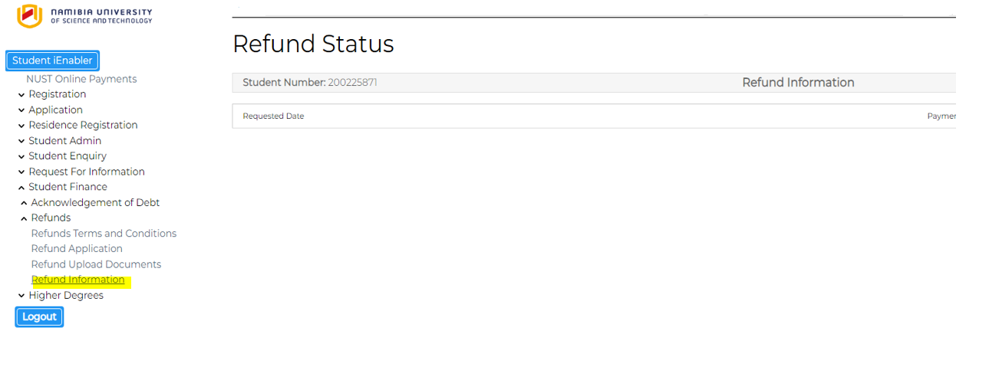
Student can check the refund status on the student kiosk, after the OACB payment:

Slide 23
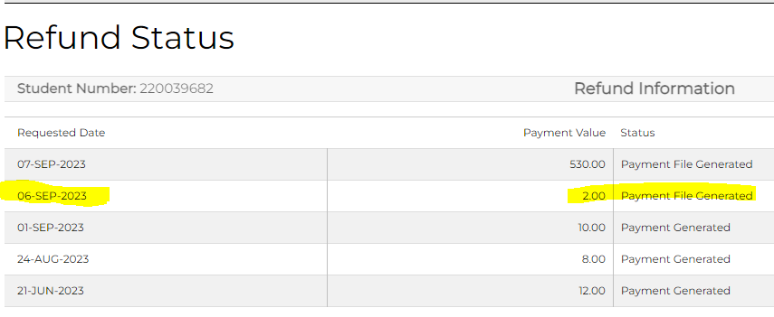
The refund status will appear as “Payment File Generated” once the payment tape was generated on OACB-1 concluding the SD refund business process

Slide 24
THE PROCESS ON THE SYSTEM: CASHBOOK

Slide 25
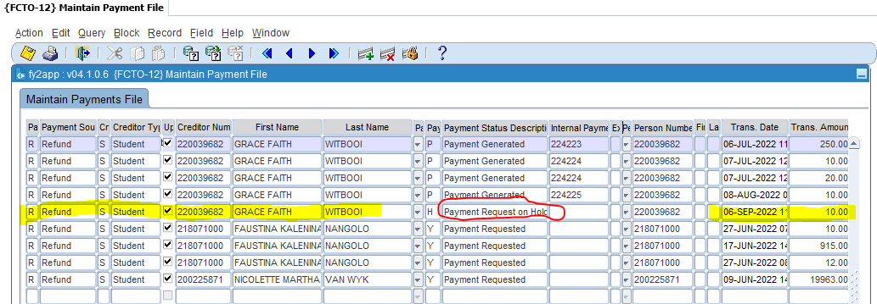
FCTO-12: After the process on i-Enabler is done, payment gets created with an “On Hold Status” Payment status “Payment request on Hold”:

Slide 26
FSAO-16 : With each refund application, create the EFT transaction with the bank details uploaded on the kiosk attached: Finance need to authorize the payment for the refund (After the receipt of the e-mail notification to verify/authorize the banking details):

Slide 27
Before payment is done on FCTO-12, the amount can be lessened on LFCTO-1 : The initial amount was N$ 10.00 This is local software as NUST do not allow for students to withdraw the full amount, thus created LFCTO-1 to overwrite the amount the student tenders.

Slide 28
CONTINUE LFCTO-1: Before amount is changed:

Slide 29
MENU: LFCTO-1: Unapproved Refund Transactions LFCTO-1 : After the amount is changed to N$ 8.00:

Slide 30
MENU: FCTO-12: Maintain Payment File Payment status changed to “Payment requested” once “Pay all” is selected and the refund transaction is saved:

Slide 31
FCTO-20: Generate Payments from Payments File The payment is generated retrieving the records from the payments file {FCTO-12}

Slide 32
Report output on FCTO-20: Generate Payments from Payment File

Slide 33
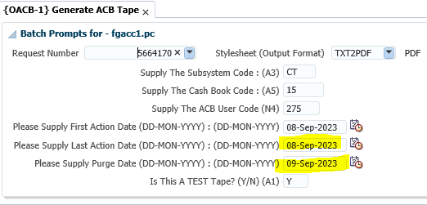
OACB-1 parameters: Take note of the dates to be the next business date for action and purge dates

Slide 34
OACB REPORTS AFTER GENERATING ACB TAPE

Slide 36
STUDENT I-ENABLER: ONCE OACB-1 PROCESS IS CONCLUDED, THE STUDENT WILL BE ABLE TO VIEW THE REFUND STATUS AS “PAYMENT GENERATED”

Slide 37
Proof of registration/statement:

Slide 38
OBURS-4: Once you are done with the refund payment on OACB-1, the amount is updated on the proof of registration/statement with the reference number and the ACB reference number

Slide 39
MENU: FCTO-6: Enter Cheque Transactions This option is used to query/retrieve the completed refunds transactions

Slide 40
Run the report of the refund payments for audit trial: MENU: FCTOR1-30: Payment Analysis Report Parameters:

Slide 41
Run the payment analysis report of the refunds payments on : MENU: FCTOR1-30: Payment Analysis Report Kindly note that once the SD refund business process is concluded on OACB-1, the report shown “Payment File generated” on the report

Slide 42
THANK YOU.
QUESTIONS?

